Slide 1
Why College Will Soon Be About Credegrees
Presented By

Slide 2
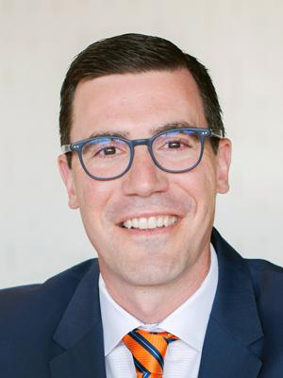
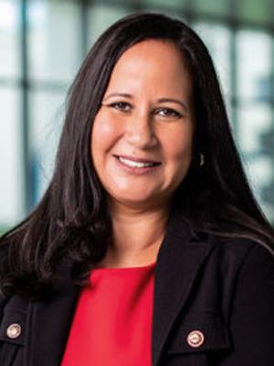
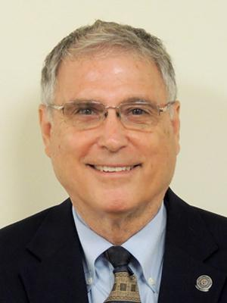
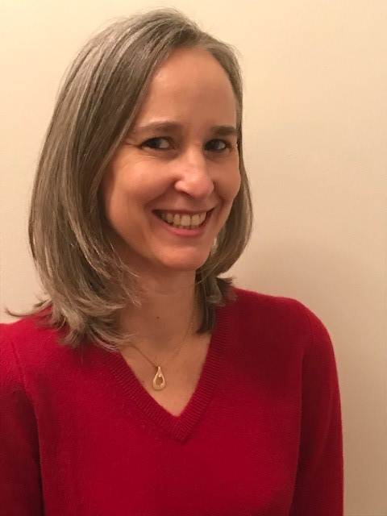
Presenters
Brandon Busteed President, University Partners—Kaplan, Inc.
Katrina Carter-Tellison Vice President for Academic Affairs, Lynn University
Roy Swift Executive Director, Workcred
Karen Elzey Associate Executive Director,
Workcred
Brandon leads Kaplan’s work serving U.S. colleges and universities to help them adapt, grow, and thrive. Previously, Busteed was Global Head of Public Sector at Gallup.
Katrina oversees curriculum, accreditation, faculty assessment and development, career services, international student services, and study abroad at Lynn University.
Roy is the executive director of Workcred, an affiliate of ANSI. Previously, he served as the chief workforce development officer and senior director of accreditation programs at ANSI.
As associate executive director, Karen advances Workcred’s mission to strengthen workforce quality by improving the credentialing system, ensuring its relevance, and preparing its users.

Slide 3
Agenda
01
What’s a Credegree™? Why Now?
02
Lynn University’s Credegree Strategy
03
Integrating Certifications into Bachelor’s Degree Programs
04
Questions

Slide 4
What’s a Credegree?
Why Now?

Slide 5
What Americans Want from Higher Ed: To Get a Good Job
67%
88%
38%
Americans: “very important” reason for getting education beyond high school
Top reasons freshmen cite for going to college
Parents of 5th-12th graders: “very important” reason for getting education beyond high school
Sources: Lumina Foundation/Gallup Poll 2013, The 2013 Inside Higher Ed Survey of College & University Chief Academic Officers Report
Copyright © 2018 Gallup, Inc. All rights reserved.

Slide 6
Is Higher Education Preparing Students for Work?
13%
11%
4%
of Americans strongly agree that college graduates in this country are well‐ prepared for success in the workplace
of business leaders strongly agree that graduating students have the skills and competencies their businesses need
of trustees strongly agree that colleges and universities have a good understanding of what employers are looking for in a job candidate
.
Sources: Lumina Foundation/Gallup Poll 2013, The 2013 Inside Higher Ed Survey of College & University Chief Academic Officers Report
Copyright © 2018 Gallup, Inc. All rights reserved.

Slide 7
THE ACADEMY THINKS SO…
95%
of Chief Academic Officers rate their institution as very/somewhat effective at preparing students for the world of work.
Sources: Gallup/Lumina poll, UCLA CIRP, Gallup/IHE poll
7
Copyright © 2018 Gallup, Inc. All rights reserved.

Slide 8
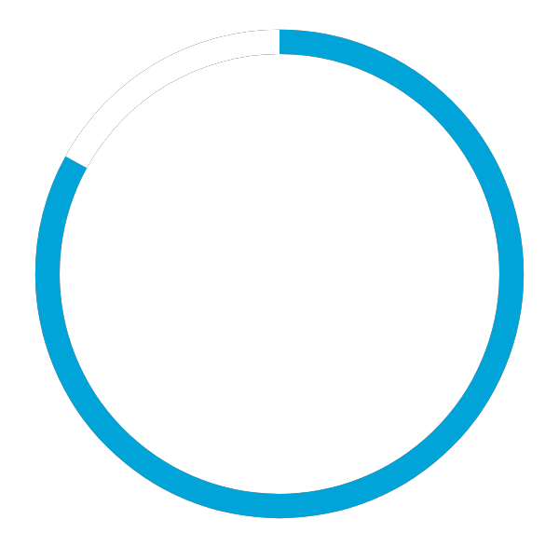
COURSEWORK IS DIRECTLY RELEVANT TO WHAT YOU DO AT WORK.
28%
STRONGLY AGREE
ONLY ONE-QUARTER OF AMERICAN WORKERS
AGREE STRONGLY THAT THEIR PAST COURSEWORK
IS DIRECTLY RELEVANT TO THE WORK THEY DO.
Source: Strada-Gallup Education Consumer Survey
8
Copyright © 2018 Gallup, Inc. All rights reserved.

Slide 9
The Most In-Demand Hard & Soft Skills
HARD SKILLS
1 | Cloud Computing
2 | Artificial Intelligence
3 | Analytical Reasoning
4 | People Management
5 | Ux Design
SOFT SKILLS
1 | Creativity
2 | Persuasion
3 | Collaboration
4 | Adaptability
5 | Time Management
IN-DEMAND SKILLS APPLY TO MANY DIFFERENT JOB TYPES
Source: Petrone. LinkedIn, January, 2019.

Slide 10
Hybrid Jobs on the Rise
58%
Hybrid Skills Are Required to Compete
Key Hybrid Skills | Skills—Select Examples (Growth in Demand, 2013–2018) | Job Roles—Select Examples (Growth in Jobs, 2013–2018)
Big Data & Analytics | Tableau (733%) R (298%) Data Analysis (86%) SQL (45%) | Data Scientist (663%) Marketing Data Analyst (194%) Financial Quantitative Analyst (57%)
Intersection of Design & Development | JavaScript (78%) Adobe InDesign (76%) UI / UX (25%) | UI / UX Designer (35%)
Sales & Customer Service | CRM (138%) | Financial Relationship Manager (73%)
Emerging Digital Technologies | Tableau (1103%) Chef (553%) Apache Hadoop (306%) | BI Architect (47%)
Evolving Compliance & Regulatory Landscape | Legal Compliance (81%) Auditing (54%) | IT Auditor (69%)
of all current entry-level openings have some level of hybridization.
Source: Bersin. Burning Glass, January, 2019.

Slide 11
How likely would you be to hire a recent college grad with a Credegree?
KAPLAN INSIGHTS
Extremely likely
OVER 50%
of respondents said they would be extremely or very likely to hire a grad with a Credegree.
Very likely
1,207
Somewhat likely
RESPONDENTS
Not very likely
Not at all likely
Source: Quest Research Group Survey of 2,000 U.S. adults. 12/12/2019

Slide 12
To what extent do you agree that Credegree would better prepare a student for the world of work?
KAPLAN INSIGHTS
Extremely likely
OVER 70%
of respondents markedly agreed that Credegree would better prepare a student for the world of work.
Very likely
2,000
Somewhat likely
RESPONDENTS
Not very likely
Not at all likely
Source: Quest Research Group Survey of 2,000 U.S. adults. 12/12/2019

Slide 13
To what extent do you agree that Credegree would make a student more marketable to a potential employer?
KAPLAN INSIGHTS
Extremely likely
OVER 65%
of respondents markedly agreed that Credegree would make a student more marketable to a potential employer.
Very likely
2,000
Somewhat likely
RESPONDENTS
Not very likely
Not at all likely
Source: Quest Research Group Survey of 2,000 U.S. adults. 12/12/2019

Slide 14
To what extent do you agree that Credegree would help a student become more well-rounded in their overall education and skill set?
KAPLAN INSIGHTS
Extremely likely
OVER 70%
of respondents markedly agreed that Credegree would help a student become more well-rounded in their overall education and skill set.
Very likely
2,000
Somewhat likely
RESPONDENTS
Not very likely
Not at all likely
Source: Quest Research Group Survey of 2,000 U.S. adults. 12/12/2019

Slide 15
Imagine you are a hiring manager for a top employer. Which candidate would you hire among the following recent graduates?
KAPLAN INSIGHTS
U.S. adults are four times more likely to say they’d hire an English major with a credential over an English major with no credential, and they are nearly three times more likely to say they’d hire an English major with a credential over the fast-growing STEM major in cybersecurity.
English major
2,000
Cybersecurity Major
RESPONDENTS
English major with industry credential
Source: Quest Research Group Survey of 2,000 U.S. adults. 12/12/2019

Slide 16
Market Opportunities
A quickly moving market: Degree + credential is a differentiator
Combine select degrees with industry-recognized credentials allows IHEs to:
Increase the value of a degree—perceived and tangible
Position graduates more effectively for the job market
Effectively fend off the work readiness critique of higher education
Attract more corporate partnerships for internships and recruiting
Notes:
The point on this slide is that these things are not only what we suggest to our university partners, but these also fit with our ethos as a company:
We must think boldly if we are going to be trusted to deliver to our university partners
We are taking deliberate actions to address key issues facing higher ed revenue and enrollment growth, but we are not doing it with everyone…we are being discerning
We won’t partner with folks if there is not mission-alignment between our organizations
We firmly believe in the power of partnership – long term, mission aligned, well capitalized, growth minded, etc.
We stand out from some of our colleagues, many of whom are well intentioned but who are constrained by the organizations that they work for – so they only offer “one size fits all” (this is a better way to talk about those that are not as well capitalized, those that offer simply an OPM version…helps us talk about how we “aren’t an OPM” or “aren’t just an international recruitment organization” without actually saying it outright.

Slide 17
Kaplan’s Distinct Value Proposition
10,000 relationships and partnerships with corporations and businesses around the world
Global reach coupled with localized expertise
Leader in learning measurement through diagnostics and assessments
Data-driven learning science
Breadth of verticals: cybersecurity, data science, financial services, real estate, engineering, wealth management, health care
Notes:
The point on this slide is that these things are not only what we suggest to our university partners, but these also fit with our ethos as a company:
We must think boldly if we are going to be trusted to deliver to our university partners
We are taking deliberate actions to address key issues facing higher ed revenue and enrollment growth, but we are not doing it with everyone…we are being discerning
We won’t partner with folks if there is not mission-alignment between our organizations
We firmly believe in the power of partnership – long term, mission aligned, well capitalized, growth minded, etc.
We stand out from some of our colleagues, many of whom are well intentioned but who are constrained by the organizations that they work for – so they only offer “one size fits all” (this is a better way to talk about those that are not as well capitalized, those that offer simply an OPM version…helps us talk about how we “aren’t an OPM” or “aren’t just an international recruitment organization” without actually saying it outright.

Slide 18
Dr. Katrina Carter-Tellison— Vice President for Academic Affairs
lynn.edu

Slide 19
About Lynn
Independent college based in Boca Raton, Florida
Approximately 3,000 students from nearly 100 countries
Named by U.S. News & World Report among the most innovative and international universities
Four-time Apple Distinguished School
Dialogues curriculum and award-winning iPad program help Lynn graduates gain the intellectual flexibility and global experience to fulfill their potential in an ever-changing world
Notes:
The point on this slide is that these things are not only what we suggest to our university partners, but these also fit with our ethos as a company:
We must think boldly if we are going to be trusted to deliver to our university partners
We are taking deliberate actions to address key issues facing higher ed revenue and enrollment growth, but we are not doing it with everyone…we are being discerning
We won’t partner with folks if there is not mission-alignment between our organizations
We firmly believe in the power of partnership – long term, mission aligned, well capitalized, growth minded, etc.
We stand out from some of our colleagues, many of whom are well intentioned but who are constrained by the organizations that they work for – so they only offer “one size fits all” (this is a better way to talk about those that are not as well capitalized, those that offer simply an OPM version…helps us talk about how we “aren’t an OPM” or “aren’t just an international recruitment organization” without actually saying it outright.

Slide 20
Core Curriculum: The Dialogues
Launched interdisciplinary core curriculum in Fall 2008
Reverse Design—focus on “what students need to know” and “be able to do”
Embedded essential skills
Notes:
The point on this slide is that these things are not only what we suggest to our university partners, but these also fit with our ethos as a company:
We must think boldly if we are going to be trusted to deliver to our university partners
We are taking deliberate actions to address key issues facing higher ed revenue and enrollment growth, but we are not doing it with everyone…we are being discerning
We won’t partner with folks if there is not mission-alignment between our organizations
We firmly believe in the power of partnership – long term, mission aligned, well capitalized, growth minded, etc.
We stand out from some of our colleagues, many of whom are well intentioned but who are constrained by the organizations that they work for – so they only offer “one size fits all” (this is a better way to talk about those that are not as well capitalized, those that offer simply an OPM version…helps us talk about how we “aren’t an OPM” or “aren’t just an international recruitment organization” without actually saying it outright.

Slide 21
Essential Skills? Degree + Credegree
What should go across the curriculum?
What can be embedded in the majors?
Notes:
The point on this slide is that these things are not only what we suggest to our university partners, but these also fit with our ethos as a company:
We must think boldly if we are going to be trusted to deliver to our university partners
We are taking deliberate actions to address key issues facing higher ed revenue and enrollment growth, but we are not doing it with everyone…we are being discerning
We won’t partner with folks if there is not mission-alignment between our organizations
We firmly believe in the power of partnership – long term, mission aligned, well capitalized, growth minded, etc.
We stand out from some of our colleagues, many of whom are well intentioned but who are constrained by the organizations that they work for – so they only offer “one size fits all” (this is a better way to talk about those that are not as well capitalized, those that offer simply an OPM version…helps us talk about how we “aren’t an OPM” or “aren’t just an international recruitment organization” without actually saying it outright.

Slide 22
Major | Certification
Cyber Security | Security +
Data Analytics | Introduction to Data Science Beginner Python and Math for Data Science
Business and Management (All majors) | Microsoft Certification Package: Word, Excel, Access, PowerPoint
Graphic Design | Adobe Dreamweaver Certification (DW-ACE) Adobe Illustrator Certified Expert (IL-ACE) Adobe InDesign Certified Expert (ID-ACE)
Business and Management Political Science | Certified Associate in Project Management (CAPM)
Data Literacy (Core Curriculum—all undergraduate students)
Notes:
The point on this slide is that these things are not only what we suggest to our university partners, but these also fit with our ethos as a company:
We must think boldly if we are going to be trusted to deliver to our university partners
We are taking deliberate actions to address key issues facing higher ed revenue and enrollment growth, but we are not doing it with everyone…we are being discerning
We won’t partner with folks if there is not mission-alignment between our organizations
We firmly believe in the power of partnership – long term, mission aligned, well capitalized, growth minded, etc.
We stand out from some of our colleagues, many of whom are well intentioned but who are constrained by the organizations that they work for – so they only offer “one size fits all” (this is a better way to talk about those that are not as well capitalized, those that offer simply an OPM version…helps us talk about how we “aren’t an OPM” or “aren’t just an international recruitment organization” without actually saying it outright.

Slide 23
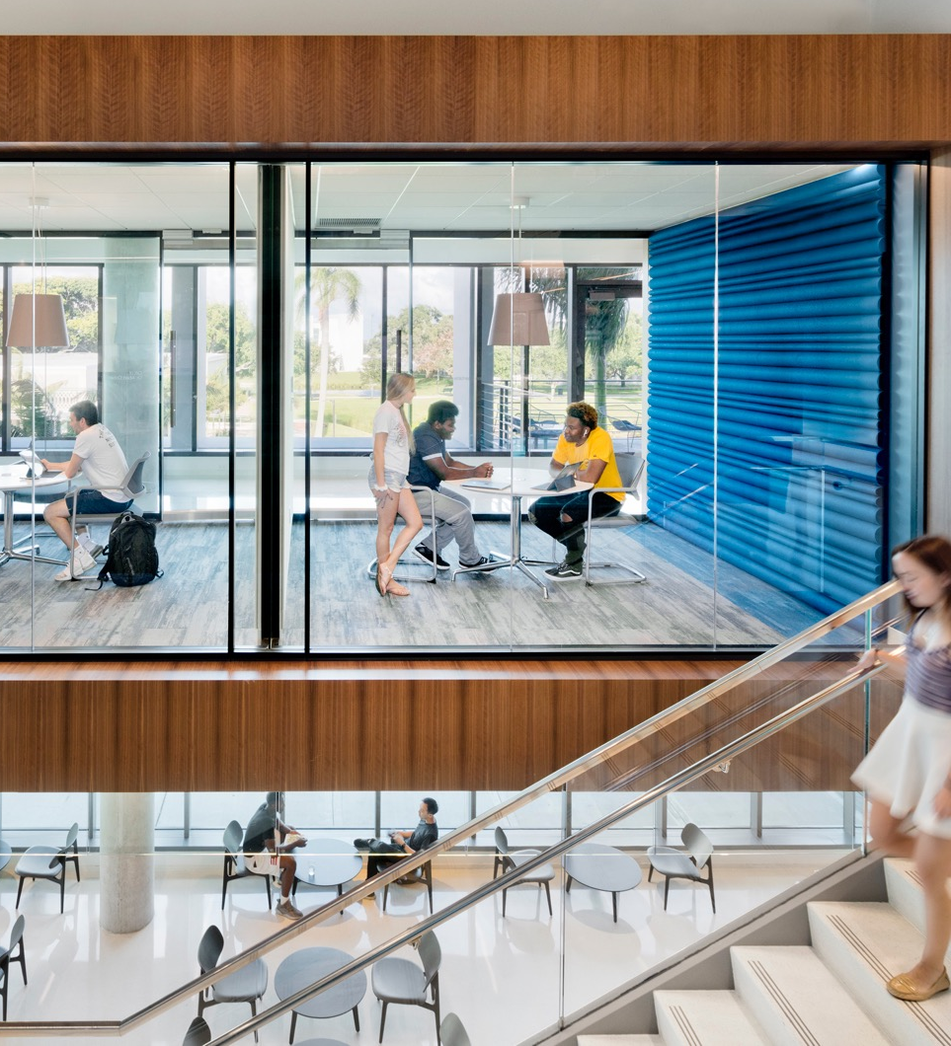
Implementation Strategies: So where does all this fit?
Embedded in traditional (15 week) semester
Embedded in January (3 week) Term—Career Preparation Courses
Notes:
The point on this slide is that these things are not only what we suggest to our university partners, but these also fit with our ethos as a company:
We must think boldly if we are going to be trusted to deliver to our university partners
We are taking deliberate actions to address key issues facing higher ed revenue and enrollment growth, but we are not doing it with everyone…we are being discerning
We won’t partner with folks if there is not mission-alignment between our organizations
We firmly believe in the power of partnership – long term, mission aligned, well capitalized, growth minded, etc.
We stand out from some of our colleagues, many of whom are well intentioned but who are constrained by the organizations that they work for – so they only offer “one size fits all” (this is a better way to talk about those that are not as well capitalized, those that offer simply an OPM version…helps us talk about how we “aren’t an OPM” or “aren’t just an international recruitment organization” without actually saying it outright.

Slide 24
Integrating Certifications into Bachelor’s Degree Programs

Slide 25
Project Background
Funded by:
Partners:
Goals:
Convene credentialing bodies and universities to:
Explore how students can earn both degrees and certifications as part of their four-year degree program
Create new opportunities for students to earn credentials with labor-market value

Slide 26
Key Themes from Convenings
Need consensus on the definitions of certificates and certifications
Provide continuing education for faculty
Determine the value and quality of certifications
Develop a matrix about certifications
Obtain buy-in at all levels of the certification bodies and universities

Slide 27
How Likely Participants Are to Pursue a Partnership to Better Align Programs’ Curricula
 | April Health Care |  | July Cybersecurity |  | October Liberal Arts |  | December Manufacturing
Pre-Convening Responses | Certification Body | University | Certification Body | University | Certification Body | University | Certification Body | University
Definitely Likely | 25% | 17% | 50% | 0% | 29% | 0% | 20% | 9%
Somewhat Likely | 50% | 50% | 17% | 70% | 29% | 33% | 80% | 64%
Not Very Likely | 25% | 17% | 17% | 30% | 29% | 67% | 0% | 27%
Not Likely at All | 0% | 17% | 17% | 0% | 13% | 0% | 0% | 0%
 | April Health Care |  | July Cybersecurity |  | October Liberal Arts |  | December Manufacturing
Pre-Convening Responses | Certification Body | University | Certification Body | University | Certification Body | University | Certification Body | University
Definitely Likely | 47% | 44% | 44% | 32% | 50% | 8% | 50% | 25%
Somewhat Likely | 33% | 44% | 36% | 53% | 33% | 62% | 30% | 64%
Not Very Likely | 7% | 6% | 20% | 11% | 17% | 23% | 0% | 0%
Not Likely at All | 0% | 0% | 0% | 0% | 0% | 0% | 0% | 0%
Not Applicable | 13% | 6% | 0% | 5% | 0% | 8% | 20% | 11%
*Data figures in the tables were rounded to the nearest whole number; as a result, columns may not add up to exactly 100%.

Slide 28
Questions?

Slide 29
Thank you
Visit www.Kaplan.com/credegree
to learn more.

